Slide 1
Greatest and Least:
New Functions to Improve Our Messy T-SQL
Edward Pollack
Microsoft Data Platform MVP
Data Architect
Transfinder

Slide 2




Our sponsors
Please consider to vist their websites, as we are able to finance the costs thanks to them.
DATA BASH is a non profit event with an non profit organization behind it, and without our sponsors,
we would not be able to finance the event.

Slide 3
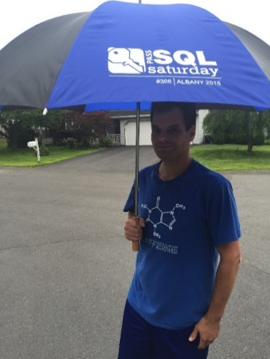





Ed Pollack
Microsoft Data Platform MVP
Published author of:
Dynamic SQL: Applications, Performance, and Security, 2nd Edition
Analytics Optimization with Columnstore Indexes in SQL Server
Published in Expert T-SQL Functions in SQL Server, 3rd Edition
Expert Performance Indexing in SQL Server, 4th Edition
Author on SQLServerCentral, SQLShack, and Simple Talk.
Organizes:
SQL Saturday New York City
Future Data Driven
Capital Area SQL Server User Group
Speaker at many data events
Find me on: LinkedIn

Slide 4
Agenda
What are GREATEST and LEAST?
What did our old, hacky code look like?
What does our new, shiny code look like?
Rejoice!

Slide 5
GREATEST and LEAST
Provides the smallest and largest values per row across any number* of columns.
Is *NOT* an aggregate function (like SUM, MIN, AVG, etc..).
Introduced in SQL Server 2022. No compatibility level requirement.
Replaces messy, hard-to-read code with something much better.
*Up to 254, in case you were wondering

Slide 6
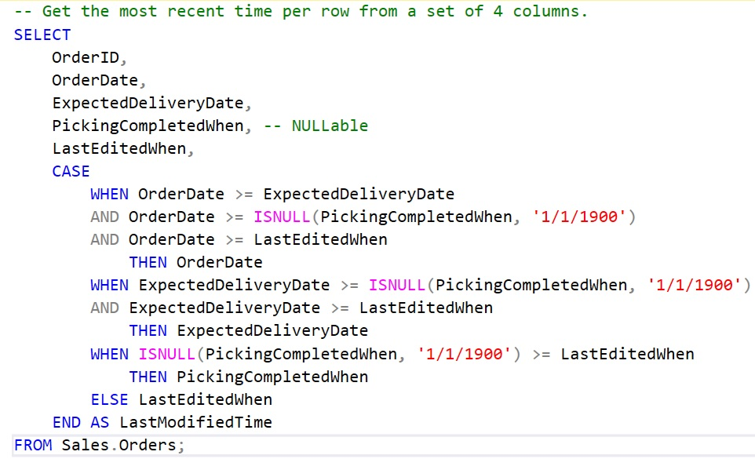
What Our Code Used to Look Like (1)
CASE statement evaluates each column value versus the rest, one-at-a-time:

Slide 7
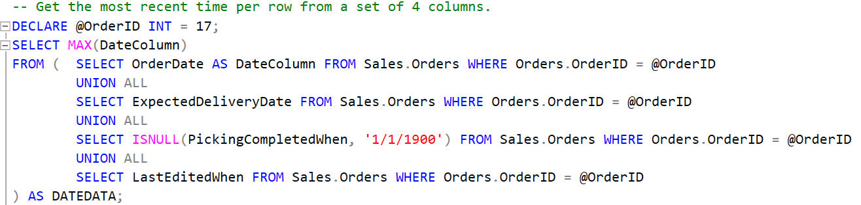
What Our Code Used to Look Like (2)
Select the MAX value from a UNION of values to compare:

Slide 8
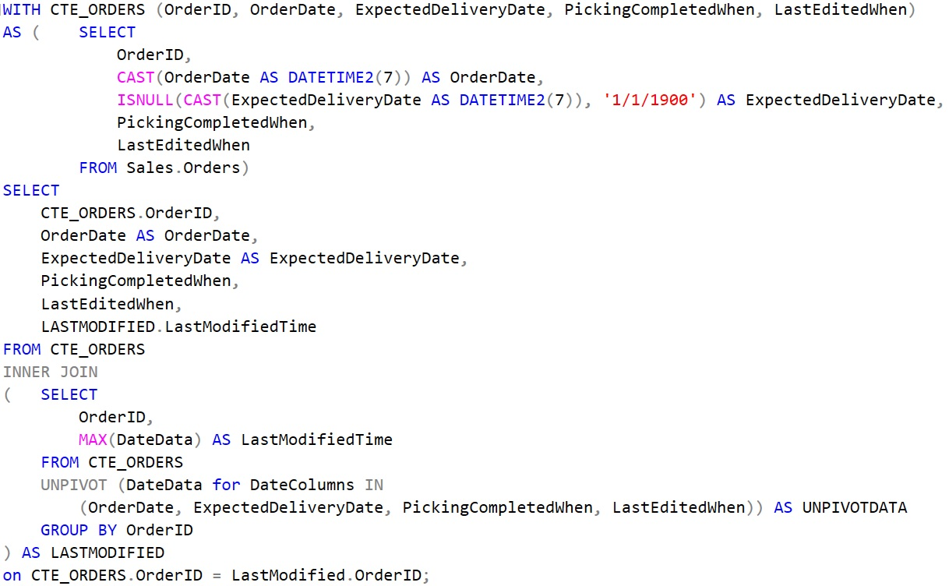
What Our Code Used to Look Like (3)
Maximize confusion with UNPIVOT:

Slide 9
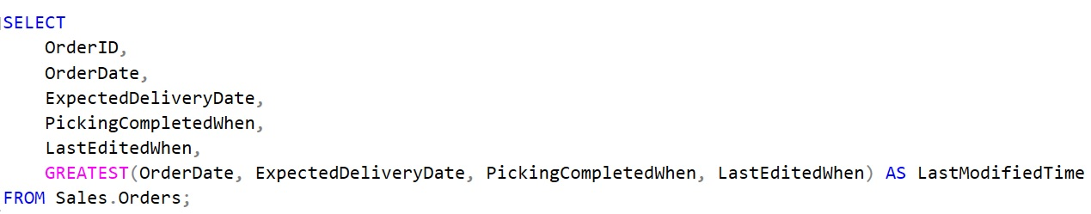
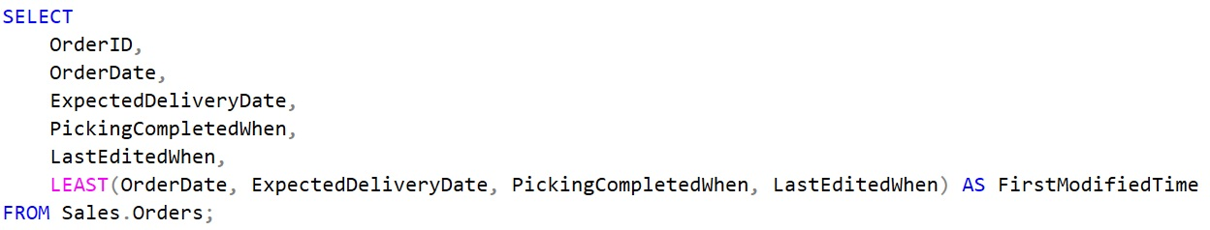
What Our Code Can Look Like Now
GREATEST:
LEAST:

Slide 10
Keeping it Simple!
Old Version #1: 12 lines of code (via a long CASE statement)
Old Version #2: 9 lines of code (via a subquery and aggregation)
Old Version #3: 26 lines of code (via aggregation using UNPIVOT)
New Version: 1 LINE OF CODE!

Slide 11
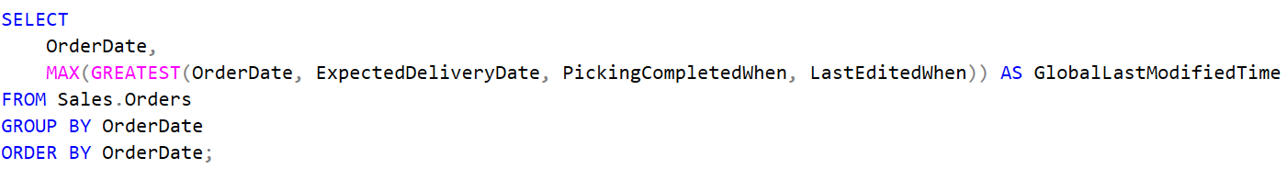
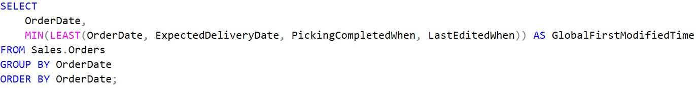
Aggregation of GREATEST/LEAST
GREATEST/LEAST can be aggregated on:

Slide 12
What Next?
Write new code using GREATEST and LEAST, when SQL Server 2022 is available.
These are ANSI standard functions and can be used in other SQL variants, such as Postgres, MySQL, and many others.
Refactor old code to be faster and easier to read.
Don’t have 2022? Flag/document old code for future refactoring.

Slide 13
Conclusion
GREATEST and LEAST provide a clean way to get the largest or smallest value from a set of columns.
Can be aggregated further, if needed.
Performs better than many of the old/verbose solutions.
Available in SQL Server 2022+

Slide 14
Thank You!
Edward Pollack
@EdwardPollack
ed@edwardpollack.com
Ed Pollack | LinkedIn

